Slide 1

Exploratory Data Analysis
-Investment Opportunity Analysis for Taxi Companies
21-03-2024

Slide 2
Agenda
Executive Summary
Problem Statement
Approach
EDA
EDA Summary
Recommendations

Slide 3
Case Study
Problem Statement
-XYZ is a private firm in US. Due to remarkable growth in the Cab Industry in last few years and multiple key players in the market, it is planning for an investment in Cab industry and as per their Go-to-Market(G2M) strategy they want to understand the market before taking final decision.
Objective
-To provide insights on the cab companies to help XYZ firm to make the right investment decisions
Areas Investigated
Which company has the maximum number of cab users at a particular time period?
Does the margin proportionally increase with the increase in number of customers?
What are the attributes of these customer segments?

Slide 4
Data Exploration
Given Data
-Cab Data.csv:
359392 Rows and 7 Features (Transaction_ID, Date_of_Travel, Company, City, KM_Travelled, Price_Charged, Cost_of_Trip , State)
-Customer_ID.csv:
20 Rows and 3 Features (Customer_ID, Gender, Age, Income_(USD/Month))
-Transaction_ID.csv
49171 Rows and 4 Features (Transaction ID, Customer ID, Payment_Mode)
-City.csv
440098 Rows and 4 Features (City, Population, Users, State)
Data is analysed and processed as one master data
master_data.csv
359392 Rows and 18 Features
15 (Transaction_ID, Date_of_Travel, Company, City , KM_Travelled , Price_Charged , Cost_of_Trip , State , Customer_ID , Payment_Mode , Gender , Age , Income_(USD/Month) Population , Users) + 3 (Year, Profit_per_KM, Profit)

Slide 5
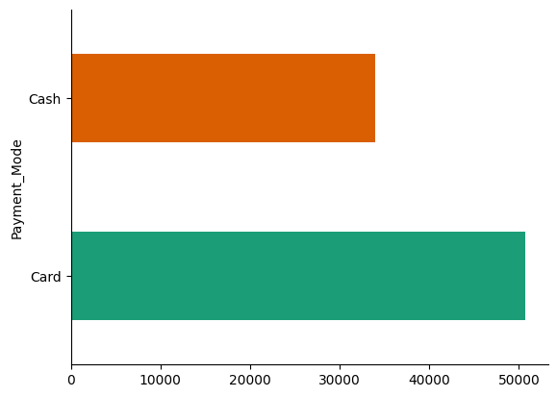

PAYMENT MODES
-For both the cab data have cash and card payments equally regardless of the number of customers

Slide 6
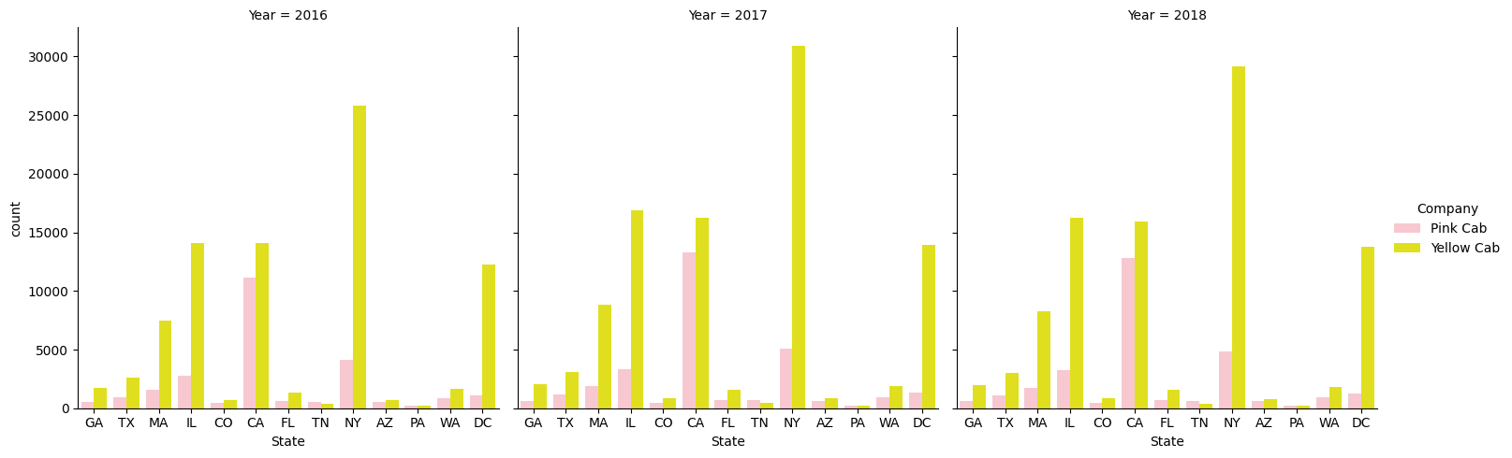
STATE WISE ANNUAL PROFIT

Slide 7
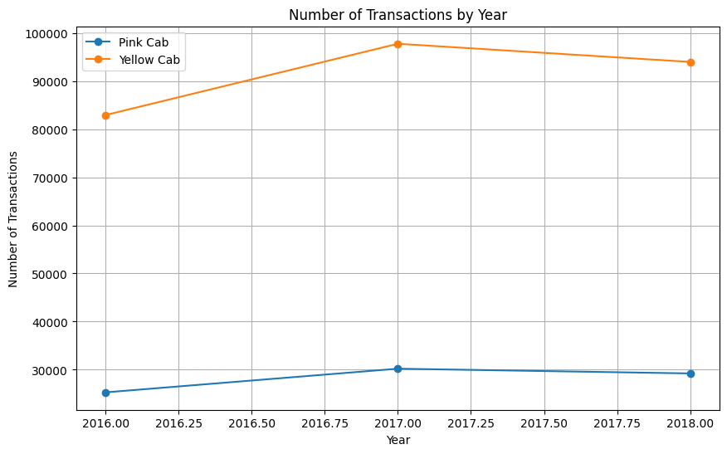
PROFIT ANALYSIS BASED ON NUMBER OF CUSTOMERS
-Yellow cab has more profit, undoubtedly as they have more customers
- We could also see that regardless of the number of customers there has been an increase in the profit for both cabs in the year 2017 and has been stable till the next year
-Yellow cab undoubtedly is the most popular cab in 5 major states with the more population

Slide 8
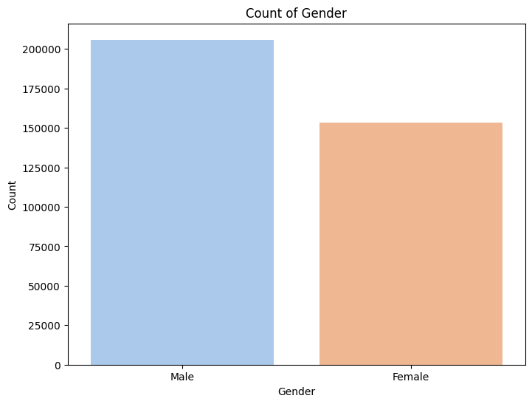
GENDER ANALYSIS OF CAB USAGE
Gender distribution is the same when compared so let's not focus on gender constrain

Slide 9
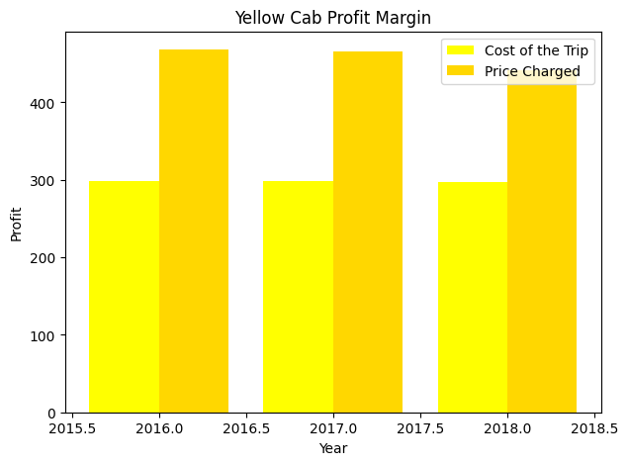
YELLOW CAB PROFIT MARGIN
-We could also see that the profit margin for the yellow cab is high, it is calculated by deducting the cost of the trip from the price charged
-The profit margin is the same from 2015-2018

Slide 10
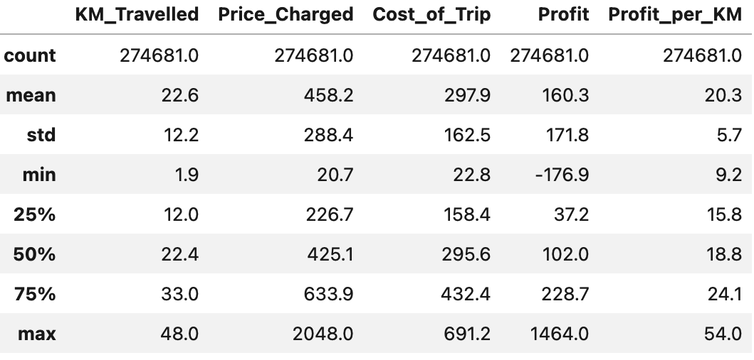
YELLOW CAB PROFIT MARGIN
-The profit is higher because of the number of customers using the cab.
-From the data, it is clear that the profit margin for the Yellow cab is high when compared with the pink cab.

Slide 11
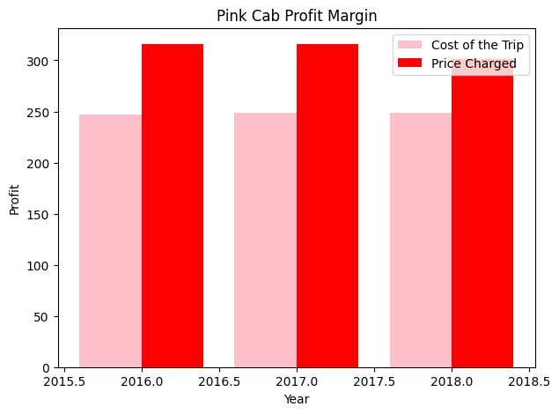
PINK CAB PROFIT MARGIN
-We could also see that the profit margin for the pink cab is low, it is calculated by deducting the cost of the trip from the price charged
-The profit margin is the same from 2015-2018

Slide 12
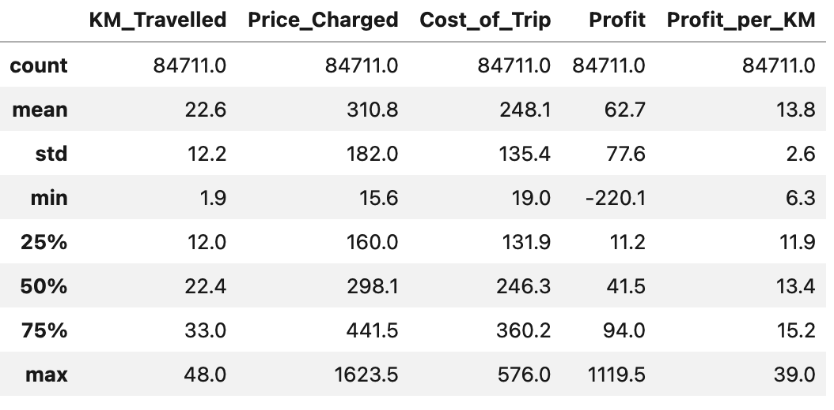
PINK CAB PROFIT MARGIN
-The profit is lower because of the number of customers using the cab.
-From the data, it is clear that the profit margin for the pink cab is low when compared with the pink cab.

Slide 13
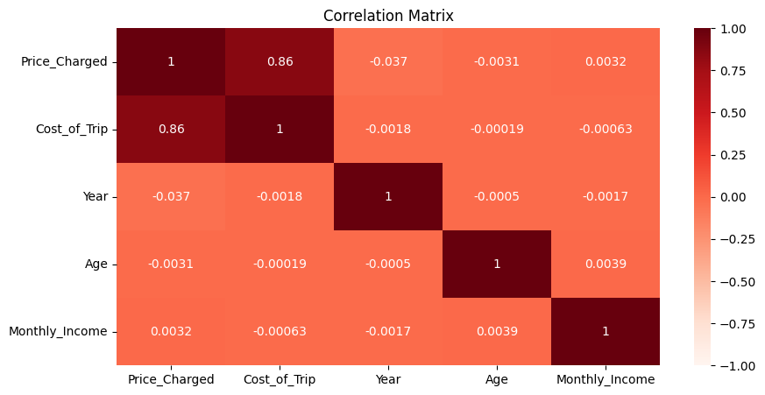

Slide 14
EDA Summary & Recommendations
After comparing the two taxi services on the following criteria, we determined that Yellow Cab was superior to Pink Cab
-Yellow Cab's profit per ride is statistically substantially greater. -There is a homogenous temporal statistical difference. -According to a seasonal breakdown of daily revenues per firm, Yellow Cab's trend is significantly higher than Pink Cab's. -All firms have statistically similar income per client. -There is statistical similarity in age demographics between firms. -Based on the offered study, it is evident that the Yellow Cab firm is a better investment.

Slide 15
Further Explorations
- Note that the data covers the historical era from 2016 to 2018, which is a long time ago yet may not be considered a huge amount of time.
- Better analysis may benefit from future data analysis that includes profit margin based on city weather forecasts.

Slide 16
THANK YOU

